Slide 1

How
works as a distributed system

Slide 2
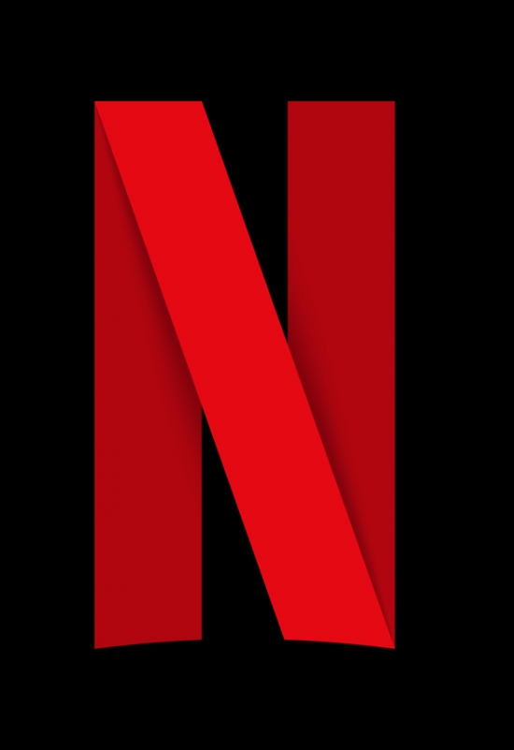
Distributed system
_____________________________________
What is it?
Its a group of informatic programs that uses computer resources in different nodes to accomplish one shared goal
Why?
Eliminate the bottlenecks or errors of a central system
______________
___________
________
____

Slide 3



Background
_______________________
Netflix has more than 110 million subscribers.
Netflix operates in more than 200 countries.
Netflix adds more than 5 million new subscribers per quarter.
Netflix played 250 million hours of video on a single day in 2017.
Netflix accounts for over 37% of peak internet traffic in the United States.
streams 1 billion hours of video each week.
streams 1 billion hours of video every day
110 million hours of video every day.
______________
___________
________
____

Slide 4
History
______________
Netflix launched in 1998. At first, they rented DVDs through the US Postal Service, but they saw the future was on-demand streaming video
In 2007 Netflix introduced their streaming video-on-demand service that allowed subscribers to stream television series and films
Netflix began by running their own datacenters. The problem here was they were growing so fast, and they realized they were bad at building datacenters, but they were great delivering video to their members.
They move to AWS, it offered highly reliable databases, storage and redundant datacenters
______________
___________
________
____

Slide 5
Netflix and the cloud
_________________________________________
They key to success of Netflix is using two different clouds:
AWS
Open Connect
Both clouds work seamlessly to deliver endless hours of customer-pleasing
______________
___________
________
____

Slide 6
Netflix and the cloud
_________________________________________
We can divide Netflix in three parts:
Client
Backend
Content delivery network
______________
___________
________
____

Slide 7

Netflix and the cloud
_________________________________________
Client
Backend
Content delivery network
The client is the user interface on any device used to browse and play Netflix videos. It could be an app, website on your computer or an app on a Smart TV
Everything that happens in the backend, which runs in AWS, like preparing all new incoming videos and handling request from all aps/websites
Everything that happens after you hit play is handled by Open Connect. Open Connect stores Netflix video in different locations throughout the world, the videos streams from Open Connect
______________
___________
________
____

Slide 8
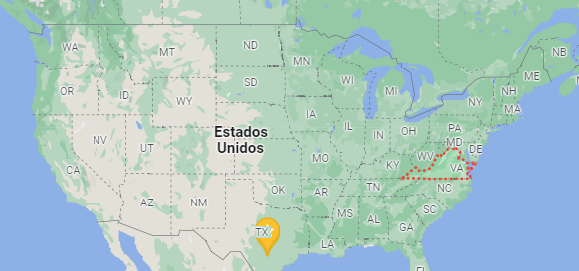
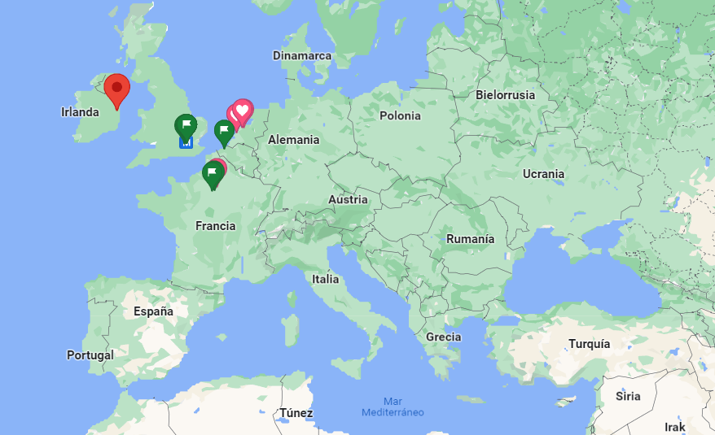
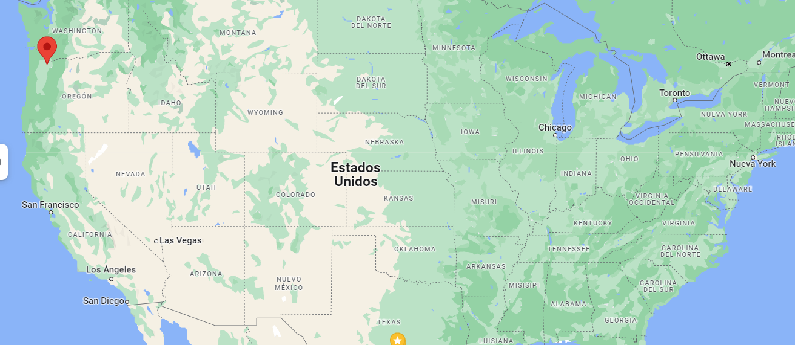
Netflix and AWS
________________________________
Netflix operates out of three AWS regions:
North Virginia
Portland Oregon
Dublin Ireland
______________
___________
________
____

Slide 9
Netflix and AWS
________________________________
The advantage of having three regions is that any one region can fail, and the other regions will step in handle all the members in the failed region.
If you are watching House of Cards in England. The chances are your Netflix device is connected to the Dublin region.
What happens if the entire Dublin region fails?
Netflix, after detecting the failure, redirects you to Virginia. Your device would now talk to the Virginia region instead of Dublin. You might not even notice there was a failure.
When a region fails, Netflix call this an evacuating region. Netflix runs monthly tests. Netflix causes a region fail on purpose to make sure its system can handle region level failures. A region can be evacuated in six minutes
______________
___________
________
____

Slide 10
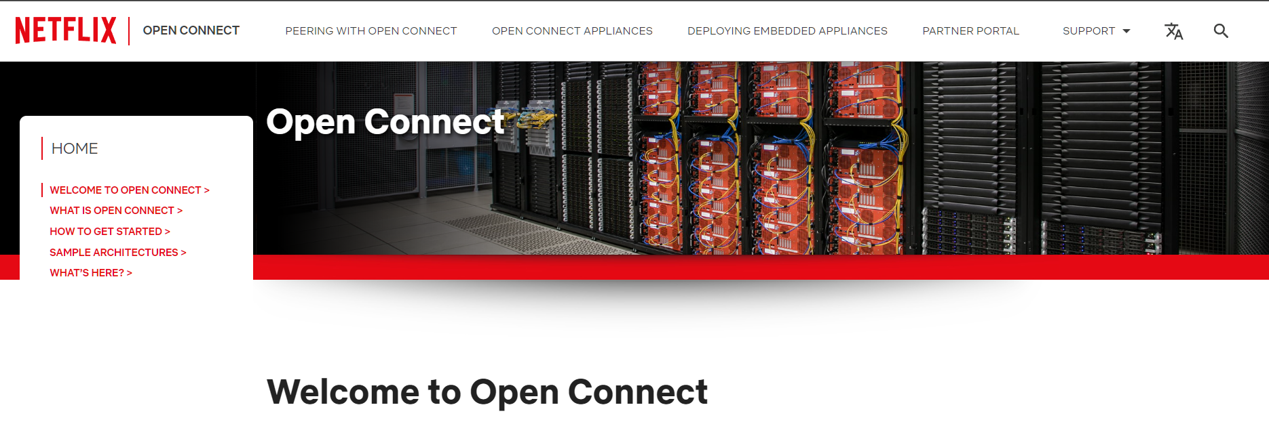
Netflix and Open Connect
___________________________________________________
The goal of the Netflix Open Connect program is to provide our millions of Netflix subscribers the highest-quality viewing experience possible. We achieve this goal by partnering with Internet Service Providers (ISPs) to deliver our content more efficiently
______________
___________
________
____

Slide 11
Netflix and Open Connect
___________________________________________________
In 2011 Netflix realized it needed a dedicated CDN (Content delivery network) to maximize network efficiency
Advantages:
Less expensive, 3rd party CDN are expensive, doing it themselves save them a lot of money
Better quality, by controlling the entire video full path they can deliver a superior video experience
More scalable, Netflix wants to provide services all around the world, so it needed to build their own system
Netflix knows exactly who its users are because they must subscribe to Netflix, it knows exactly which videos it needs to serve, this make smart optimization that others CDN can't make.
______________
___________
________
____

Slide 12
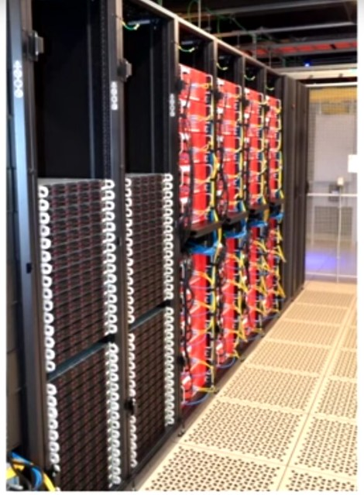
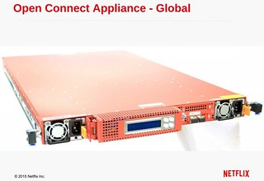
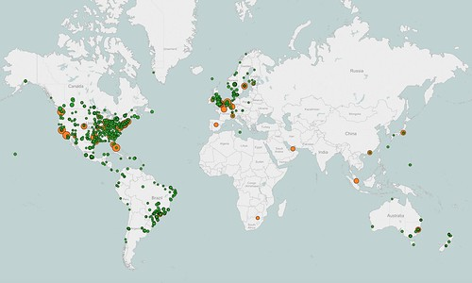
Open Connect Appliances (OCAs)
___________________________________________________
Netflix developed its own computer system for video storage. Netflix calls them Open Connect Appliances or OCAs.
Each OCA is a fast server, highly optimized for delivering large files, with lots and lots of hard disks or flash drives for storing video.
______________
___________
________
____

Slide 13
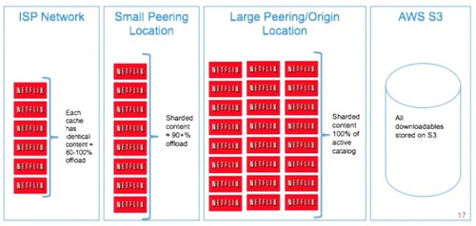
Open Connect Appliances (OCAs)
___________________________________________________
Netflix uses its popularity data to predict which videos members probably will want to watch tomorrow in each location.
Netflix copies the predicted videos to one or more OCAs at each location.
This gives great service to members. The video they want to watch is already close to them, ready and available for streaming.
Every night, each OCA wakes up and asks a service in AWS which videos it should have. The service in AWS sends the OCA a list of videos it’s supposed to have.
______________
___________
________
____

Slide 14
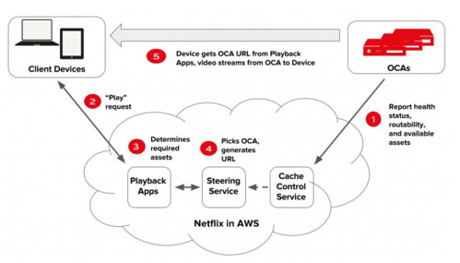
Open Connect Appliances (OCAs)
___________________________________________________
Just like Netflix uses three different AWS regions. The architecture of Open Connect works the same way.
If an OCA fails, the Netflix client you’re using immediately switches to another OCA and resumes streaming.
If there is too many people in one location, The Netflix client will find a more lightly loaded OCA to use.
______________
___________
________
____

Slide 15
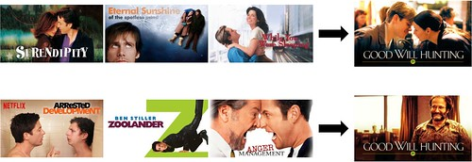
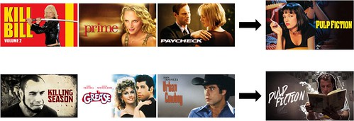
Fun fact
___________________________________________________
______________
___________
________
____

